Slide 1
Brexit with Boris…
Philip Shaw, Chief Economist
Investec Bank plc
14-17 October 2019
Channel Islands

Slide 2
Please ensure you have updated
your footer information
STEPS
  From the ribbon select ‘View’ tab and click on ‘Slide Master’
  In slide master view – ensure you select the very first page
  Update footer text
  FOOTER TEXT
  Type in the updated footer text – this text will update throughout the presentation
  Click on ‘Close master view’
 | Brexit
 | ‘No-deal’ Brexit
 | Economy
 | Conclusions
1
2
3
4

Slide 3
Where is the Brexit process?
31 Oct
Current leaving date still 31 Oct; third deadline! This is the default.
Brexit talks
May deal’ agreed by UK/EU negotiators in November ‘18.
Another delay?
‘Benn Act’ forces Boris to request 3m delay if no deal by 19 Oct.
EU27 needs to agree unanimously. Could offer longer extension?
PM strategy - convince EU27 that parliament cannot stop no-deal.
Boris submitted counter proposal on different arrangements for Irish border.
NI in regulatory union with RoI/ EU. NI part of UK customs territory.
Rejected by EU, but modified? Deal rather than extension at Summit 17/18 Oct??
No deal Brexit would hurt UK, but also EU. EU does not want the blame…
EU27 would likely agree to delay? No-deal departure on 31 Oct unlikely.
Can Boris refuse to request/accept extension? Not legally!
Parliament to meet on 19 Oct – first Saturday sitting since 1982.

Slide 4
The significance of the Irish backstop
UK trade benefits as EU member - i) tariff free trade; ii) no customs checks (part of European Customs Union); iii) no regulatory checks (member of EU Single Market).
On a free trade agreement (FTA), if ii) & iii) are removed, relevant checks required. EU concerned about protecting Single Market.
Hence the Irish ‘backstop’ was included in Theresa May’s plan as a fallback arrangement.
CU/SM options off the table. In absence of other ‘magic solution’, a ‘hard’ border between NI/RoI would be needed.

Slide 5
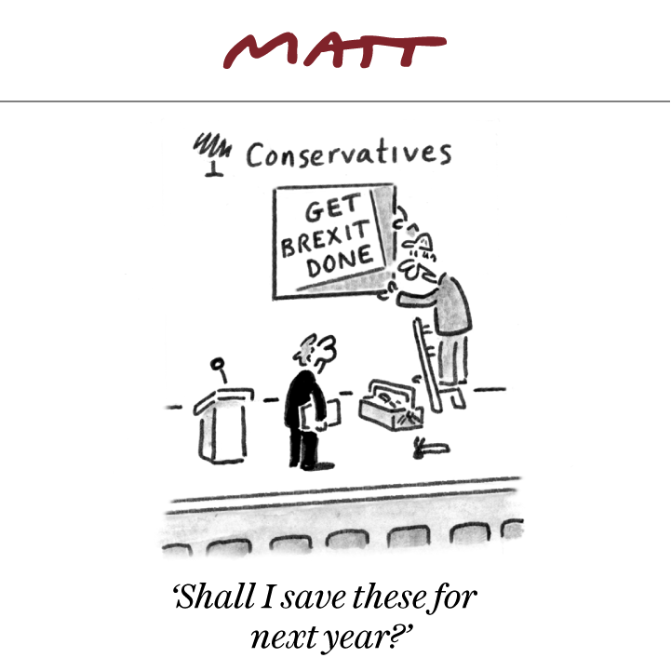
We hope this is not where we are…
Source: Matt, telegraph.co.uk

Slide 6


Evolving deals…
May’s deal
In summary:
Political Declaration (PD): future relationship.
Transition period to end-2020. Option to be extended by 2 years.
May sought customs sharing arrangement – frictionless border & ability to strike 3rd party trade deals.
Backstop – UK in customs union with EU; NI & EU partial regulatory alignment. Kicks in if NI/RoI border can’t be open.
May’s deal failed in Parliament three times: most recently by 58 (WA only).
Problems and answers??!!
Worries were that the UK would be ‘trapped’ in the backstop
NI treated differently to GB.
PD vague outline of future trading arrangements.
Conservative/DUP confidence & supply agreement restricted government wiggle room.
Latest govt proposal a compromise i.e. NI/EU regulatory union. Would need NI approval (also every 4 years). NI in UK customs territory.
Boris plan approved by DUP. Probably would pass through Parliament!
Withdrawal Agreement (WA): leaving arrangements incl. Irish backstop.
Updated plan under consideration in Brussels – significant!
Guidance note
To use text/bullet formatting levels correctly, use the Increase List Level and Decrease List Level buttons from the Paragraph group on the Home tab.
Alternatively you can use the keyboard shortcuts:
Shift+Alt+Right arrow key = increase level
Shift+Alt+Left arrow key = decrease level.

Slide 7
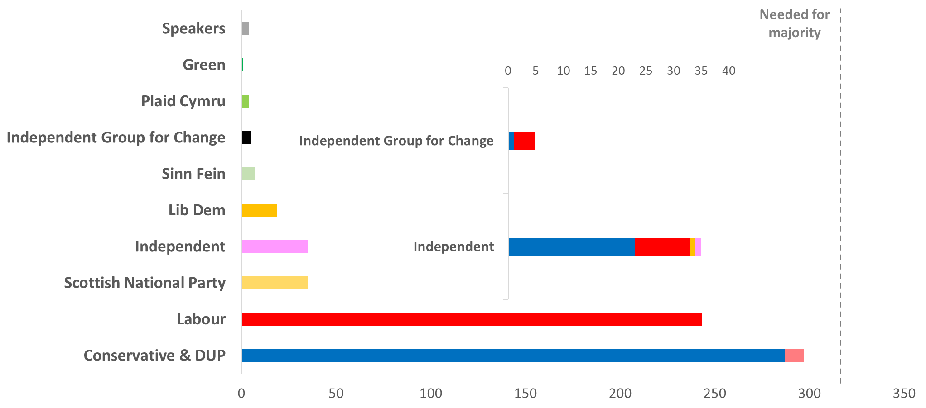
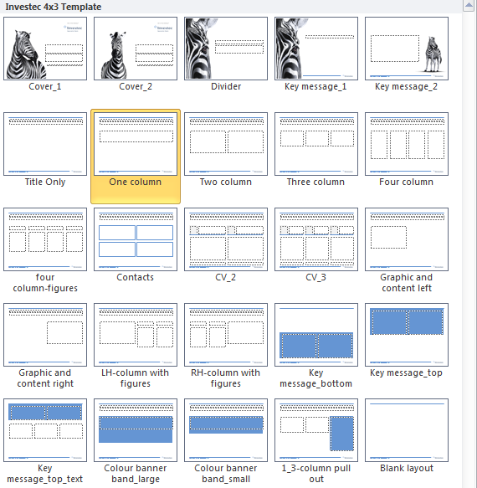
Current parliamentary arithmetic (11 Oct 2019)
Guidance note
To use text/bullet formatting levels correctly, use the Increase List Level and Decrease List Level buttons from the Paragraph group on the Home tab.
Alternatively you can use the keyboard shortcuts:
Shift+Alt+Right arrow key = increase level
Shift+Alt+Left arrow key = decrease level.
Reapplying the Slide Layout
Putting text into a placeholder not only ensures the text sits in th correct place and is formatted correctly, it also helps to update the page quickly and efficiently.
      If you require an Investec Bank template:
      Right click on any part of slide
      Click on ‘Layout’
      Select the layout you require
4
19
35
23
10
35
243
287
10
Government effectively 45 short of majority (with DUP support)
Excludes abstentionists Sinn Fein, the Speaker and his 3 deputies
Source: www.parliament.uk, Investec

Slide 8
The current state of politics…
No majority
Can this be recovered?
Queen’s Speech
Election
Gov’t effectively 45 short of a majority. Cannot govern - unsustainable.
21 rebels had the whip removed. Is a reconciliation (with most) possible?
Debate taking place this week/early next week. Government could lose.
Will Corbyn call a vote of no confidence? Will PM try to call an election?

Slide 9
Election dynamics…
Election?
Fixed-term Parliaments Act requires a 2/3 majority i.e. 434 for govt to call an election.
Polls?
PM tried twice and failed.
If Corbyn wins vote of no confidence, 2 weeks to seek govt that could command a majority. If not, election takes place.
Could head towards 12 December (or thereabouts) election. First December election since 1918!
Opinion polls vary, but Tory lead averages 10% over Labour. Lib Dems close behind in 3rd.
Many Labour MPs are wary about forcing election. Corbyn may decide not to.
In theory Conservatives would get an overall majority. BUT distribution of vote changes likely to be uneven. Cannot rely on a Uniform National Swing.
Attitudes to Brexit will be a big (not the only) driver.

Slide 10
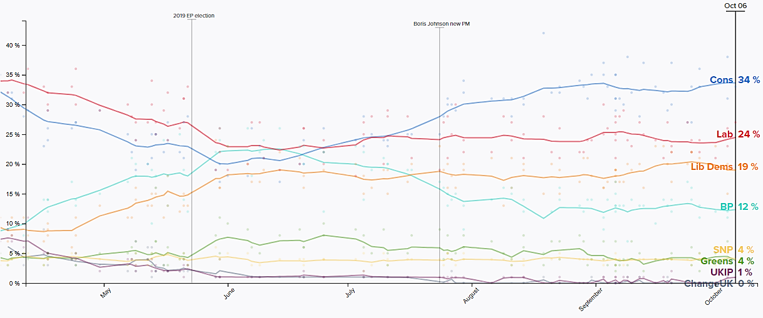
Poll of polls (i.e. opinion poll averages)
Source: Politico

Slide 11
Key pre-election points
Tories vulnerable
Likely lose seats in London; elsewhere in SE; SW; Scotland.
Tory pick ups?
Midlands; North; Wales. Sufficient seats there?
Brexit not done?
Tories likely to increase lead once UK has left EU.
Conclusions
Will enough Labour voters switch? Need more than in 2017!
How much will Brexit Party split the Conservative vote? Is Brexit done??
Boris aiming to persuade everyone that a delay to leaving EU would not be his fault! Minimise voter defections to the Brexit Party.
Boris aiming to fight election post-Brexit. Should lead to overall Conservative majority.
Fighting election while UK is still in EU may well lead to another hung parliament!

Slide 12
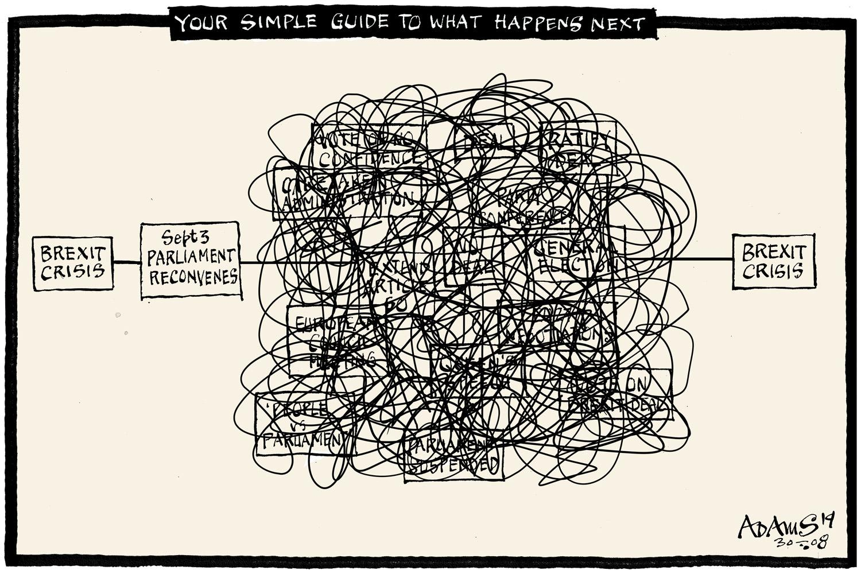
Realistic Brexit flow chart…

Slide 13
Please ensure you have updated
your footer information
STEPS
  From the ribbon select ‘View’ tab and click on ‘Slide Master’
  In slide master view – ensure you select the very first page
  Update footer text
  FOOTER TEXT
  Type in the updated footer text – this text will update throughout the presentation
  Click on ‘Close master view’
 | Brexit
 | ‘No-deal’ Brexit
 | Economy
 | Conclusions
1
2
3
4

Slide 14
Some implications of ‘no deal’
Loss of EU trade arrangements
UK exporters face WTO tariffs; customs checks; regulatory checks; restrictions on services access.
Concerns over social stability (worst case scenario ‘Project Yellowhammer’
Fuel & medicines shortages; lower food availability; fuel supplies disrupted.
UK government would introduce mitigating measures
Temporary import tariffs (88% at 0%); transitional procedures for importers.
Macro policy
No deal looking less likely now…
Many firms less competitive (despite likely fall in £); delays at ports etc.
BoE suggests GDP could fall by up to 5½%; lower rates?
Govt would turn fiscal taps on more – spending, corporation tax.

Slide 15
Please ensure you have updated
your footer information
STEPS
  From the ribbon select ‘View’ tab and click on ‘Slide Master’
  In slide master view – ensure you select the very first page
  Update footer text
  FOOTER TEXT
  Type in the updated footer text – this text will update throughout the presentation
  Click on ‘Close master view’
 | Brexit
 | ‘No-deal’ Brexit
 | Economy
 | Conclusions
1
2
3
4

Slide 16
How is the global economy doing?
World GDP growth (largest 12 countries, % yoy) has slowed…
Guidance note
To use text/bullet formatting levels correctly, use the Increase List Level and Decrease List Level buttons from the Paragraph group on the Home tab.
Alternatively you can use the keyboard shortcuts:
Shift+Alt+Right arrow key = increase level
Shift+Alt+Left arrow key = decrease level.
Reapplying the Slide Layout
Putting text into a placeholder not only ensures the text sits in th correct place and is formatted correctly, it also helps to update the page quickly and efficiently.
      If you require an Investec Bank template:
      Right click on any part of slide
      Click on ‘Layout’
      Select the layout you require
Source: Macrobond

Slide 17
The UK economy has been feeling the squeeze
Monthly UK GDP growth
Source: Macrobond

Slide 18
Fiscal balances (£bn)
Public borrowing is now rising again
Guidance note
To use text/bullet formatting levels correctly, use the Increase List Level and Decrease List Level buttons from the Paragraph group on the Home tab.
Alternatively you can use the keyboard shortcuts:
Shift+Alt+Right arrow key = increase level
Shift+Alt+Left arrow key = decrease level.
This year
Last year (revised up)
Reapplying the Slide Layout
Putting text into a placeholder not only ensures the text sits in th correct place and is formatted correctly, it also helps to update the page quickly and efficiently.
      If you require an Investec Bank template:
      Right click on any part of slide
      Click on ‘Layout’
      Select the layout you require
Source: Macrobond

Slide 19
An economic perspective…
            US tariff increases now cover $½trn of imports from China. Beijing has retaliated.
            World trade is now falling. Global growth slowing.
            Global GDP growth to be <3% - first time since 2009.
US/China trade tensions
            45 central banks have cut rates this year!
            Calls for fiscal stimulus more prominent
            US/China trade talks positive?
Global policy changes
            Brexit deal to unlock delayed business investment (our central case).
            Fiscal policy already looser – more to come.
            UK GDP forecasts 1.2% 2019 and 1.3% 2020.
            Bank rate currently 0.75%. No rate hike until 2021.
UK

Slide 20
Please ensure you have updated
your footer information
STEPS
  From the ribbon select ‘View’ tab and click on ‘Slide Master’
  In slide master view – ensure you select the very first page
  Update footer text
  FOOTER TEXT
  Type in the updated footer text – this text will update throughout the presentation
  Click on ‘Close master view’
 | Brexit
 | ‘No-deal’ Brexit
 | Economy
 | Conclusions
1
2
3
4

Slide 21
Final thoughts
Guidance note
To use text/bullet formatting levels correctly, use the Increase List Level and Decrease List Level buttons from the Paragraph group on the Home tab.
Alternatively you can use the keyboard shortcuts:
Shift+Alt+Right arrow key = increase level
Shift+Alt+Left arrow key = decrease level.
UK outlook not just dependent on Brexit
US election in 2020 gives China leverage over the US
Uncertainty of economic and policy outlook (global and UK)!
Arithmetic in parliament more positive to pass a Brexit deal?
Reapplying the Slide Layout
Putting text into a placeholder not only ensures the text sits in th correct place and is formatted correctly, it also helps to update the page quickly and efficiently.
      If you require an Investec Bank template:
      Right click on any part of slide
      Click on ‘Layout’
      Select the layout you require
Sat 19 Oct Commons sitting would be a huge stage for vote on Brexit deal
General Election after Brexit gives Boris huge advantage
Resolving
backstop
does not sort out UK/ EU trade frictions (e.g. Dover)
Countries never stop negotiating with the EU…

Slide 22

Thank you!
Guidance note
To use text/bullet formatting levels correctly, use the Increase List Level and Decrease List Level buttons from the Paragraph group on the Home tab.
Alternatively you can use the keyboard shortcuts:
Shift+Alt+Right arrow key = increase level
Shift+Alt+Left arrow key = decrease level.
Reapplying the Slide Layout
Putting text into a placeholder not only ensures the text sits in th correct place and is formatted correctly, it also helps to update the page quickly and efficiently.
      If you require an Investec Bank template:
      Right click on any part of slide
      Click on ‘Layout’
      Select the layout you require

Slide 23
Disclaimer
  This document is issued in the UK by Investec Bank plc (“Investec”), which is authorised by the Prudential Regulation Authority and regulated by the Financial Conduct Authority and the Prudential Regulation Authority. Whilst all reasonable care has been taken to ensure that the information stated herein is accurate and opinions fair and reasonable, neither Investec nor any of its directors, officers or employees shall be held responsible in any way for the contents of this document. This document is produced solely for your information and may not be copied, reproduced, further distributed to any other person or published in whole or in part for any purpose without the prior written permission of Investec.
  While the information in this document has been prepared in good faith, no representation or warranty, express or implied, is or will be made and no responsibility or liability is or will be accepted by Investec or any of its subsidiaries or affiliates or by any of their respective officers, employees or agents in relation to the accuracy, suitability or completeness of this document and any such liability is expressly disclaimed. Investec gives no undertaking to provide the recipient with access to any additional information or to update this document or any additional information, or to correct any inaccuracies in it which may become apparent.
  This document does not take into account the specific investment objectives, financial circumstances or particular needs of any recipient and it should not be regarded as a substitute for the exercise of the recipient’s own judgement. Investec does not offer investment advice or make any investment recommendations. Recipients of this document should seek independent financial advice regarding the appropriateness or otherwise of investing in any investment strategies discussed or recommended in this document and should understand that past performance is not a guide to future performance, and the value of any investments may fall as well as rise.
  Investec Corporate & Institutional Treasury is part of Investec Bank plc, of 2 Gresham Street, London, EC2V 7QP. Registered and incorporated in England No. 00489604. Investec Bank plc is authorised by the Prudential Regulation Authority and regulated by the Financial Conduct Authority and the Prudential Regulation Authority and is a member of the London Stock Exchange. Telephone calls may be monitored or recorded.

